Slide 1
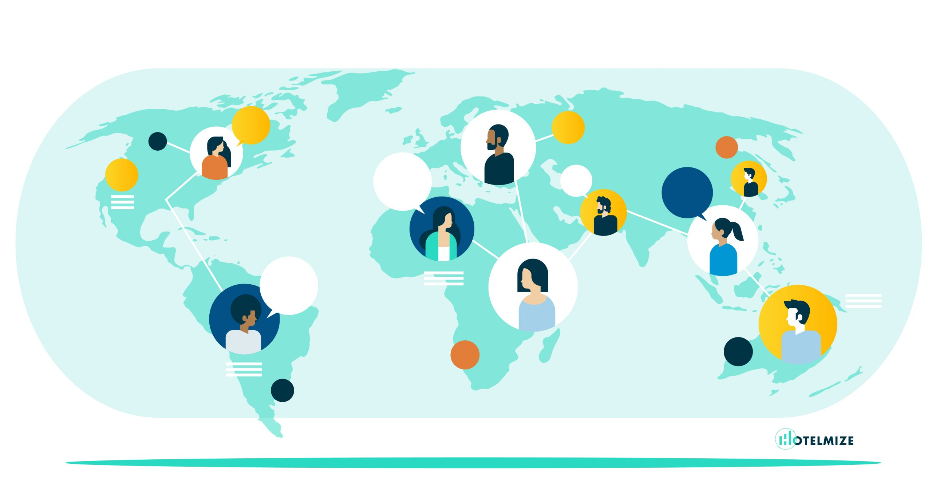

Slide 2
Meaning and Definitions of International Distribution Channels:
The sole objective of production of any commodity is to help the goods reach the ultimate consumers. In the era of modem large scale production and specialization it is not possible for the producer to fulfill this work in all circumstances. The size of market has become quite large. Therefore, the producer has to face numerous difficulties if he undertakes the distribution works himself.

Slide 3
Besides, in the age of specialization it is not justified on the part of a single person or organisation to entertain both production as well as distribution work. Thus the producer has to take help of many distribution channels to transfer the goods to the ultimate consumers. In other words, many different distribution channels are needed between producers and consumers for effective distribution of products.

Slide 4
DEFINITIONS
According to Philip Kotler, “Every producer seeks to link together the set of marketing intermediaries that best fulfil the firm’s objectives. This set of marketing intermediaries is called the marketing channel.”
According to Richard Buskirk, “Distribution channels are the systems of economic institutions through which a producer of goods delivers them into the hands of their users.”

Slide 5
According to William J. Stanton, “A channel of distribution for a product is the route taken by the title to the goods as they move from the producer to the ultimate consumers or industrial user.”
According to McCarthy, “Any sequence of institutions from the producer to the consumer, including none or any number of middlemen is called a channel of distribution.”

